Slide 1
DB2 Day 4

Slide 2
Views
TRIGGERS
DB2 – Objects.
Data Objects.
System Objects.
Notes:
In this Session we are going to discuss about the DCL, TCL statements, Views, Synonyms, Alias, DB2 objects and its types.

Slide 3
VIEW
View is like a window through which data and tables can be viewed or changed.
Derived from another table or another view
Stored as a SELECT statement only.
It is a virtual table that does not physically exist in its own right, but appears to the user as if it does.
Hence, views does not occupy extra memory.
View is created for SELECT statements.

Slide 4
Types of VIEWS
1. UPDATABLE – If the attributes of the view are from a single table.
2. NON – UPDATABLE – If the attributes of the view are from more than one table.

Slide 5
VIEW
A view has no data of its own, it manipulates data in the underlying base table
Allows the same data to be seen by different users in different views.
Syntax:
CREATE VIEW <view name>
AS
SELECT col1, col2 FROM <table name>
WHERE <col name> =value;

Slide 6
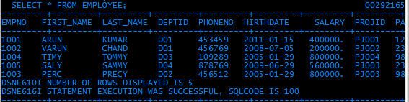
VIEW
Actual table

Slide 7

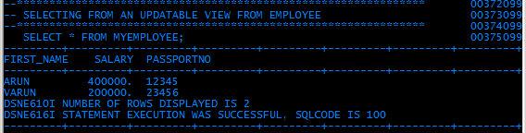
VIEW
Creating a view myemployee

Slide 8
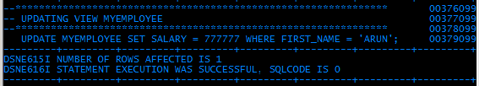
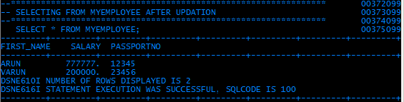
VIEW
Updating view myemployee
Updated salary 777777

Slide 9
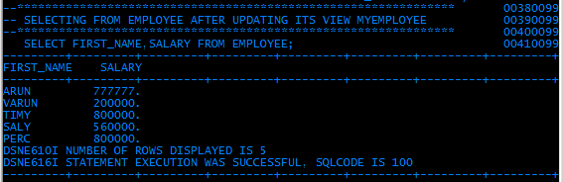
VIEW
Verifying the actual table employee for the updation.
Updated in the actual table EMPLOYEE

Slide 10
TRIGGERS
An SQL trigger is a named rule that is associated with a single base table.
A trigger is a set of actions that will be executed when a defined event occurs.
Triggers are defined for a specific table and once defined, a trigger is automatically active.
A table can have multiple triggers defined on it and the order of activation is based on the trigger creation timestamp

Slide 11
TRIGGERS
Trigger information is stored in the DB2 Catalog Tables called
    SYSIBM.SYSTRIGGERS
    SYSIBM.SYSPACKAGE
  Purpose of Triggers
    To do data validation
    To maintain data integrity

Slide 12
TRIGGERS
COMPONENTS OF TRIGGERS
        Trigger name
        Activation time
        Events
        On table name
        Transition Variables
        Granularity
        Mode
        Action

Slide 13
TRIGGERS
NAME
The trigger can be named with any unique name of user’s choice

Slide 14
TRIGGERS
ACTIVATION TIME
This specifies when the trigger should be activated
        BEFORE
        AFTER

Slide 15
TRIGGERS
ACTIVATION TIME - BEFORE
  Will activate THE TRIGGER BEFORE the trigger event occurs.
  The trigger body receives the new data values prior to its trigger event

Slide 16
TRIGGERS
ACTIVATION TIME - AFTER
  Will activate THE TRIGGER AFTER the trigger event occurs.
  The trigger body sees the table as being in a consistent state. (All transactions have been completed)

Slide 17
TRIGGERS
EVENTS
The triggering event can be the following SQL statements
  INSERT
  UPDATE
  DELETE

Slide 18
TRIGGERS
ON TABLE NAME
  It specifies the name of the table for which the trigger is created.
        Syntax: ON <TABLE NAME>

Slide 19
TRIGGERS
TRANSITION VARIABLES
– USING REFERENCING CLAUSE
  It is used to refer to a row (s) that is not a member of a table.
  To refer to a row before inserting.
  To refer to a row after deleting
  To refer to the old values of a row after updating.

Slide 20
TRIGGERS
TRANSITION VARIABLES
– USING REFERENCING CLAUSE
  There are two kinds of transition variables
  REFERENCING OLD AS CORRELATION-NAME
  REFERENCING NEW AS CORRELATION-NAME
CORRELATION-NAME:
It can be any name of user’s choice.
It will have the structure of the table for which the trigger is created.
Its scope is only within the trigger.

Slide 21
TRIGGERS
TRANSITION VARIABLES
1. REFERENCING OLD AS CORRELATION-NAME
Specifies a correlation name which captures the
original state of the row, that is, before the triggered action (DELETE or UPDATE) is applied to the database.

Slide 22
TRIGGERS
TRANSITION VARIABLES
1. REFERENCING NEW AS CORRELATION-NAME
Specifies a correlation name which captures the value that is, or was, used to update the row in the database when the triggered action (INSERT or UPDATE) is applied to the database.

Slide 23
TRIGGERS
GRANULARITY
  It specifies how many time the activated trigger must run
        1. FOR EACH ROW
        2. FOR EACH STATEMENT

Slide 24
TRIGGERS
GRANULARITY – FOR EACH ROW
    * It runs as many times as the number of rows in the set of affected rows.
* If you need to refer to the specific rows affected by the triggered action, use FOR EACH ROW granularity.

Slide 25
TRIGGERS
GRANULARITY – FOR EACH STATEMENT
    * It runs once for the entire trigger event.
If the set of affected rows is empty (that is, in the case of a searched UPDATE or DELETE in which the WHERE clause did not qualify any rows), a FOR EACH ROW trigger does not run. But a FOR EACH STATEMENT trigger still runs once.

Slide 26
TRIGGERS
MODE
  It specifies the mode in which the trigger is declared.
        MODE DB2SQL

Slide 27
TRIGGERS
ACTION
The activation of a trigger results in the running of its associated triggered action.
Every trigger has exactly one triggered action which, in turn, has two components:
1. An optional triggered action condition or WHEN clause
2. A set of triggered SQL statement(s).

Slide 28
TRIGGERS
ACTION
1. TRIGGERED ACTION CONDITION
The triggered action condition defines whether or
Not the set of triggered statements are performed for
The row or for the statement for which the triggered action is executing.
2. TRIGGERED SQL STATEMENT(S).
The set of triggered statements define the set of actions performed by the trigger in the database as a
consequence of its event having occurred.

Slide 29
TRIGGERS
Example
Now let us define trigger for the following scenario.
To validate that whenever a new employee joins the company, his/her salary should be > 100000
It has to be done before the insertion actually happens in the table
So we need to write an before event trigger

Slide 30
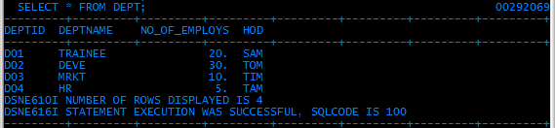
TRIGGERS
Records from EMPLOYEE and DEPT

Slide 31
TRIGGERS
Before Trigger Example
CREATE TRIGGER SALTRIG
NO CASCADE BEFORE INSERT
ON EMPLOYEE
REFERENCING NEW AS N
FOR EACH ROW MODE DB2SQL
WHEN (N.SALARY<100000)
SIGNAL SQLSTATE ‘75001’
(‘SALARY SHOULD BE GREATER THAN 10000’);
Action
TRIGGER NAME
ACTIVATION TIME
Trigger event
On table name Employee
Condition
Transition variable N
Granularity
MODE

Slide 32
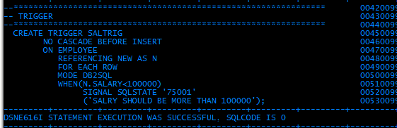
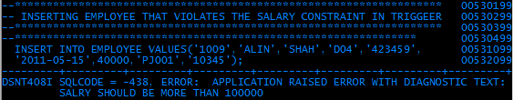
TRIGGERS
example
Displays what we have asked to display in the trigger
Trigger raised error
Salary must >100000

Slide 33
TRIGGERS
Example for After Trigger
Once the insertion is successful the <NoofEmp> in the DEPT table should be increased depending on the <Deptno> for which the employee is added
We write an AFTER Trigger

Slide 34
TRIGGERS
AFTER Trigger Example
CREATE TRIGGER UPDTRIG
AFTER INSERT
ON EMPLOYEE
REFERENCING NEW AS P
FOR EACH ROW MODE DB2SQL
UPDATE DEPT
SET NO_OF_EMPLOYS = NO_OF_EMPLOYS +1
WHERE DEPT.DEPTID=P.DEPTID;
TRIGGER NAME
ACTIVATION TIME
Action on another table
On table name Employee
Transition variable P
Granularity
MODE
Trigger event
Condition

Slide 35
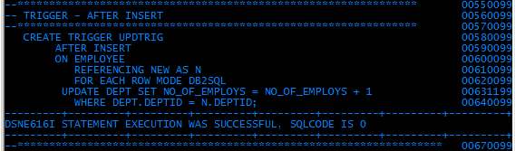
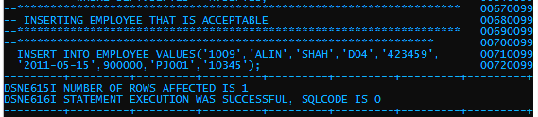
TRIGGERS
EXAMPLE

Slide 36
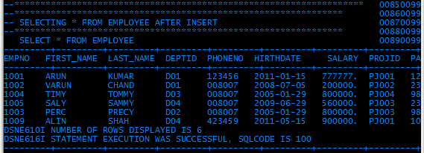
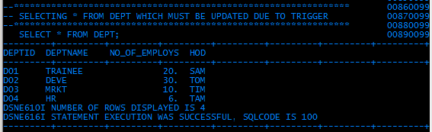
TRIGGERS
Now let us see the content of both the tables
EMPLOYEE table
Newly inserted record
DEPT table
Previously it was 5 and now updated as 6 by the trigger

Slide 37
TRIGGERS
DROP Trigger
When you no longer want a trigger we can drop the trigger
  DROP TRIGGER TRGAIORD

Slide 38
EMBEDDED SQL
Static SQL
Program Preparation.

Slide 39
DB2 objects.
There are 2 objects.
1. System objects - Controlled and used by DB2
2. Data objects - Created, accessed and manipulated by the users, but maintained by DB2

Slide 40
DB2 Objects
1. System Objects
DB2 Catalog
DB2 Directory
Boot Strap Data Set
Active and Archive Logs
Buffer Pools
Locks
2. Data Objects
Storage Groups
Databases
  Table spaces
Tables
Indexes
Views

Slide 41
1. SYSTEM OBJECTS
DB2 catalog
Set of tables containing information about everything defined to the system.
Used by DB2 to determine access path and manage resources
Table structure for catalog differs by platform.

Slide 42
SYSTEM OBJECTS
DB2 catalog
All catalog consists of a group of tables containing information about its objects.
All catalog tables have a high-level qualifier of SYSIBM.
  SYSCOLUMNS – Contains one row for every column of each table and view.
  SYSINDEXES – Contains one row for every index.
  SYSTABLES – Contains one row for each table, view and alias.
  SYSTABAUTH – Contains the privileges held by user on tables and views
  SYSRELS – Contains one row for every referential constraint.

Slide 43
SYSTEM OBJECTS
DB2 Directory(DSNDB01)
The DB2 directory contains information used byDB2 during normal operation, this data cannot be accessed using SQL.
It contains information required to start DB2, and their activities and utilities in the DB2 environment.

Slide 44
SYSTEM OBJECTS
BOOT STRAP data sets
Contains inventory of all active and archive log datasets.
During installation of DB2, two BSDS datasets are created, kept in different volumes.
Contains Archive and Active logs

Slide 45
SYSTEM OBJECTS
BOOT STRAP data sets
Active and Archive Logs
DB2 records all data changes and significant events in active logs as they occur. In case of failure, it uses this data to recover the lost information.
When the active log is full, DB2 copies the contents of the active log to a DASD or magnetic tape data set called archive logs.

Slide 46
SYSTEM OBJECTS
BUFFER POOLS
Buffer Pools are areas of virtual storage which DB2 uses during execution of an application program or an interface SQL, to temporarily store pages of tablespace

Slide 47
SYSTEM OBJECTS
LOCKS
DB2 guarantees data integrity by using several locking mechanisms. These strategies permits multiple users from multiple environments to access and modify data concurrently without lose of data integrity.
DB2 supports locking at three levels. Table Space Level, Table Level and Page Level.
DB2 uses locks to control concurrency and prevent inconsistent data.
IRLMPROC will take care of the locking services.

Slide 48
SYSTEM OBJECTS
LOCKS
Why Locking ?
‘Locking is used to provide multiple user access to the same system’.
How does DB2 manage locking ?
DB2 uses locking services provided by an MVS subsystem called the IMS Resource Lock Manager(IRLM).
The above is based on Transaction Processing - the systemcomponent that provides this is ‘TRANSACTION MANAGER’
COMMIT & ROLLBACK are key methods of implementing this.
Notes:
Why Locking is needed?
- DB2 guarantees Data integrity by using several locking mechanisms.
- These strategies permits multiple users from multiple environments to access and modify data concurrently without lose of
data integrity.
- DB2 uses locks to control concurrency and to prevent inconsistent data.
- IRLMPROC will take care of the locking services.

Slide 49
SYSTEM OBJECTS
LOCKS - explicit
Explicit locking can be achieved on a table using four methods.
The SQL statement LOCK TABLE.
2. The ISOLATION parameter on the BIND PACKAGE command - the two possible values are RR(‘Repeatable Read’)
CS(‘Cursor Stability’).
CS is the value specified if the application program is used in an online environment.
Notes:
How to achieve Explicit Locking?
Explicit locking can be achieved on a table using four methods.
1. The SQL statement LOCK TABLE.
2. The ISOLATION parameter on the BIND PACKAGE command - the two possible values are RR(‘Repeatable Read’) & CS(‘Cursor Stability’).
CS is the value specified if the application program is used in an online environment.
3. The tablespace LOCKSIZE parameter - physically DB2 locks data in terms of pages or tables or tablespaces. This parameter is specified in ‘CREATE or ALTER Tablespace’ option ‘LOCKSIZE’. The options are ‘Tablespace’, ‘Table’, ‘Page’ or ‘Any’.

Slide 50
SYSTEM OBJECTS
LOCKS - explicit
3. The tablespace LOCKSIZE parameter - physically DB2 locks data in terms of pages or tables or tablespaces. This parameter is specified in ‘CREATE or ALTER Tablespace’ option ‘LOCKSIZE’. The options are ‘Tablespace’, ‘Table’, ‘Page’ or ‘Any’.
4. The ACQUIRE/RELEASE parameters on the BIND PLAN command specifies when table locks(which are implicitly acquired by DB2) are to be acquired and released.
Types :
  ACQUIRE
    Use
    Allocate
  RELEASE
    Commit
    Deallocate
Notes:
The 4th method is, ACQUIRE/RELEASE parameters on the BIND PLAN command specifies when table locks(which are implicitly acquired by DB2) are to be acquired and released.
Types :
ACQUIRE
Use
Allocate
RELEASE
Commit
Deallocate

Slide 51
Attributes of LOCKS
SYSTEM OBJECTS
LOCKS - explicit
There 3 main attributes of Lock:
        1. MODE.
    2. SIZE.
    3. DURATION.
Notes:
There 3 main attributes of Lock:
Mode:
It Specifies what access to the locked object is permitted to the lock owner and to any concurrent application process.
3 modes :
i) Exclusive (X) :
- The lock owner can read or change the locked page.
- Concurrent Processes cannot acquire ANY lock on the page nor they access the locked page

Slide 52
Attributes 1. MODE
SYSTEM OBJECTS
LOCKS - explicit
It Specifies what access to the locked object is permitted
to the lock owner and to any concurrent application process.
3 MODES
  EXCLUSIVE(X)
  UPDATE(U)
  SHARE(S)
Notes:
There 3 main attributes of Lock:
Mode:
It Specifies what access to the locked object is permitted to the lock owner and to any concurrent application process.
3 modes :
i) Exclusive (X) :
- The lock owner can read or change the locked page.
- Concurrent Processes cannot acquire ANY lock on the page nor they access the locked page

Slide 53
Attributes 1. MODE
(a) EXCLUSIVE (X)
SYSTEM OBJECTS
LOCKS - explicit
- The lock owner can read or change the locked page.
- Concurrent Processes cannot acquire ANY
lock on the page nor they access the locked
page.
Notes:
There 3 main attributes of Lock:
Mode:
It Specifies what access to the locked object is permitted to the lock owner and to any concurrent application process.
3 modes :
i) Exclusive (X) :
- The lock owner can read or change the locked page.
- Concurrent Processes cannot acquire ANY lock on the page nor they access the locked page

Slide 54
Attributes 1. MODE
(b) UPDATE(U)
SYSTEM OBJECTS
LOCKS - explicit
- The lock owner can read but cannot change the locked page. However the owner can promote the lock to ‘X’ and update.
Notes:
There 3 main attributes of Lock:
Mode:
It Specifies what access to the locked object is permitted to the lock owner and to any concurrent application process.
3 modes :
i) Exclusive (X) :
- The lock owner can read or change the locked page.
- Concurrent Processes cannot acquire ANY lock on the page nor they access the locked page

Slide 55
Attributes 1. MODE
(c) SHARED(S)
SYSTEM OBJECTS
LOCKS - explicit
- The lock owner and any concurrent processes can read but not change the locked page.
Notes:
There 3 main attributes of Lock:
Mode:
It Specifies what access to the locked object is permitted to the lock owner and to any concurrent application process.
3 modes :
i) Exclusive (X) :
- The lock owner can read or change the locked page.
- Concurrent Processes cannot acquire ANY lock on the page nor they access the locked page

Slide 56
Db2 Locking
SYSTEM OBJECTS
LOCKS - explicit
Attributes 2. SIZE
Db2 support locking at three levels:
  Table Space level locking
  Table level locking
  Page level locking
Locks cannot be taken at a lower level, without compatible higher-level lock is also being taken.
Notes:
The second attribute is :
SIZE :
Db2 support locking at three levels:
Table Space level locking
Table level locking
Page level locking
Locks cannot be taken at a lower level, without compatible higher-level lock is also being taken

Slide 57
SYSTEM OBJECTS
LOCKS - explicit
Attributes 3.DURATION
- It is the length of time the lock is held.
- It varies according to when the lock is
acquired and released.
Notes:
The 3rd attribute of lock is:
Duration:
- It is the length of time the lock is held.
- It varies according to when the lock is acquired and released.
- This is controlled by ACQUIRE , RELEASE and ISOLATION LEVEL parameters of BIND process.

Slide 58
SYSTEM OBJECTS
LOCKS ISSUES
Lock Suspension :
- IRLM suspends an application process if it requests a lock on an object that is already owned by another application process and cannot be shared.
Deadlock :
- When 2 or more transactions are in simultaneous wait stage, each waiting for one of others to release a lock before it can proceed, DEADLOCK occurs.
Notes:
Lock Issues:
Generally Locking is introduced to avoid concurrency issues.
Lock Suspension :
- IRLM suspends an application process if it requests a lock on an object that is already owned by another application process and cannot be shared.
- The suspended process is said to be in ‘Wait stage’ for the lock.
- The process resumes when the lock is available.

Slide 59
2.DATA OBJECTS
Storage Group
It’s a set of volume on single DASD.
The volumes hold the datasets in which table spaces and indexes are actually stored.
Create stogroup MAPLESG
volumes (SMS001,SMS002)
vcat DSN610;

Slide 60
DATA OBJECTS
Database
A collection of logically related objects - like Tablespaces, Index spaces, Tables etc.
Not a physical kind of object - may occupy more than one disk space
A STOGROUP & BUFFERPOOL (is buffer area used to maintain recently accessed table and index pages) must be defined for each database.
Stogroup and user-defined VSAM are the two storage allocations for a DB2 dataset definition.

Slide 61
DATA OBJECTS
Database
In a given database, all the spaces need not have the same stogroup
More than one volume can be defined in a stogroup.
DB2 keeps track of which volume was defined first & uses that volume.
Create database MAPLEDB
stogroup MAPLESG
buffer pool BP01;
Notes:
72

Slide 62
DATA OBJECTS
Tablespace
Logical address space on secondary storage to hold one or more tables
A ‘SPACE’ is basically an extendable collection of pages with each page of size 4K or 32K bytes. (K=1024)
It is the storage unit for recovery and reorganizing purpose
Three Type of Tablespaces - Simple, Partitioned & Segmented
Notes:
74

Slide 63
DATA OBJECTS
Tablespace - Simple
Can contain more than one table
Usually only one is preferred.
Depending on application, storing more than one Table might enable faster retrieval for joins using these tables.
Can consider for highly related tables
Table Rows Inserted and deleted together
Table Rows accessed together
Notes:
76

Slide 64
DATA OBJECTS
Tablespace - Segmented
The table space is divided into equal segments.( 4 to 64 KB)
Each Segment can have only one table.
Minimize the table space scan time.
Good for small table.
A ‘Segment’ consists of a logically contiguous set of ‘n’ pages. (4 – 64).
Segsize parameter decides the allocation size for the table space.

Slide 65
DATA OBJECTS
Tablespace - Segmented
No segment is allowed to contain records for more than one table.
Sequential access to a particular table is more efficient.
Mass Delete is much more efficient than in any other Tablespace.
Reorganizing the tablespace will restore every table to its clustered order.
Lock Table on table locks only the table, not the entire tablespace.

Slide 66
DATA OBJECTS
Tablespace - Partitioned
The table space is divided into equal partitions.
The entire table space can have only one table.
Utilities can be run on one partition.
Primarily used for Very large tables.
Only one table in a partitioned TS; 2 to 64 partitions/TS .
Numpart parameter specifies the no. of partitions.
Individual partitions can be independently recovered and reorganized.
Different partitions can be stored on different storage groups for efficient access.

Slide 67
DATA OBJECTS
TABLES, INDEX AND VIEWS
Table is a logical structure of storing records.
Index is an ordered set of points to the data in a DB2 table.
An INDEX is a DB2 tool, used to locate the row or rows that contain a given value.
A view is an alternate way of representing the data.

